Slide 1
Debugging
“Quote”
– Person

Slide 2
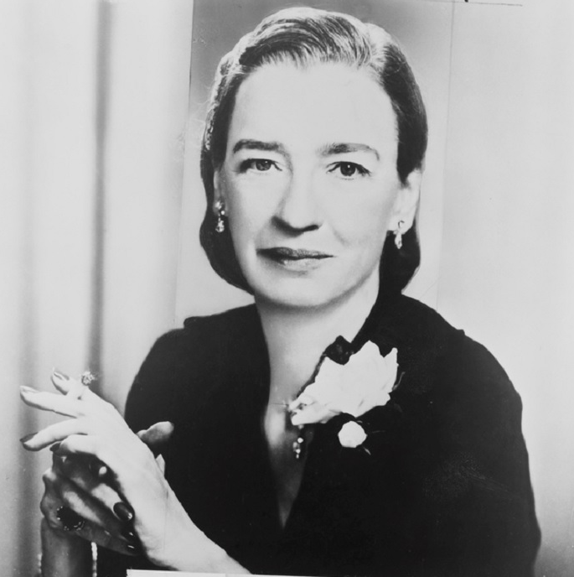
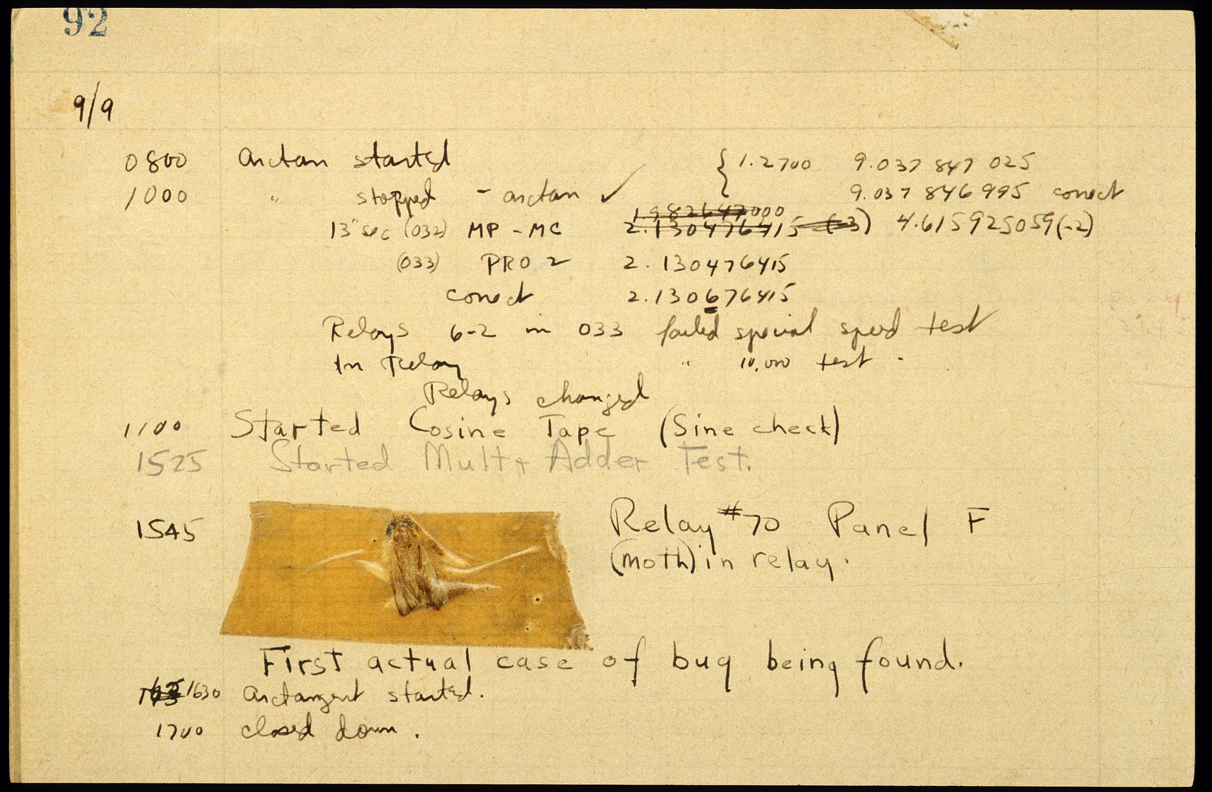
Debugging
Most of the time we spend “programming” is actually spend finding bugs.

Slide 3

Debugging Strategies
When debugging, get as much information about program state as possible:
Exceptions
Assertions
Error Stream
Breakpoints
Log Files (Later)

Slide 4
Intro to Exceptions
Many languages can handle errors via exceptions, which provides structured error signaling.
01 02 03 04 05 06 07 08 09 10 11 12
import java.util.Scanner;
public class ExceptionsForTheWin
{
public static void main(String[] args)
{
Scanner infoPlz = new Scanner(System.in);
System.out.print("What is the loneliest number? ");
int lonelyNumber = Integer.parseInt(infoPlz.next());
System.out.println("The loneliest number is " + lonelyNumber + ".");
}
}
OUTPUT:
Exception Type
Location
Message
Blarg
What is the loneliest number?
Exception in thread "main" java.lang.NumberFormatException: For input string: "Blarg"
at ...[More messages]...
at ExceptionsForTheWin.main(ExceptionsForTheWin.java:9)

Slide 5
Catching Exceptions
Exceptions can be caught so they can be gracefully handled.
07 08 09 10 11 12 13 14 15 16 17 18 19
Scanner infoPlz = new Scanner(System.in);
System.out.print("What is the loneliest number? ");
int lonelyNumber = 1;
try
{
lonelyNumber = Integer.parseInt(infoPlz.next());
}
catch (NumberFormatException ohNoes)
{
System.out.println("WAT. NOOOO!!! SNAFU.");
}
System.out.println("The loneliest number is " + lonelyNumber + ".");
OUTPUT:
Blarg
What is the loneliest number?
WAT. NOOOO!!! SNAFU.
The loneliest number is 1.
Catch blocks can be chained like if / else if blocks (e.g., try / catch / catch.)

Slide 6
Throwing Exceptions
Exceptions can be thrown to alert other code.
07 08 09 10 11 12 13 14 15 16 17 18 19
Scanner infoPlz = new Scanner(System.in);
System.out.print("What is the loneliest number? ");
int lonelyNumber = 1;
try
{
lonelyNumber = Integer.parseInt(infoPlz.next());
}
catch (NumberFormatException ohNoes)
{
throw new RuntimeException("WAT. NOOOO!!! SNAFU.");
}
System.out.println("The loneliest number is " + lonelyNumber + ".");
OUTPUT:
Blarg
What is the loneliest number?
Exception in thread "main" java.lang.RuntimeException: WAT. NOOOO!!! SNAFU.
at ThrowForTheWin.main(ThrowForTheWin.java:17)

Slide 7
Using the Error Stream
You can access the error stream in Java just like the output stream:
07 08 09 10 11 12 13 14 15 16 17 18 19
Scanner infoPlz = new Scanner(System.in);
System.out.print("What is the loneliest number? ");
int lonelyNumber = 1;
try
{
lonelyNumber = Integer.parseInt(infoPlz.next());
}
catch (NumberFormatException ohNoes)
{
System.err.println("WAT. NOOOO!!! SNAFU.");
}
System.out.println("The loneliest number is " + lonelyNumber + ".");
OUTPUT:
Blarg
What is the loneliest number?
The loneliest number is 1.
WAT. NOOOO!!! SNAFU.
Note the error and standard output streams are not coordinated!

Slide 8
Assertions
An assertion is a statement that tests a condition we expect to be true.
07 08 09 10 11 12 13
Scanner infoPlz = new Scanner(System.in);
System.out.print("What is the loneliest number? ");
int lonelyNumber = Integer.parseInt(infoPlz.next());
assert lonelyNumber > 0 : "Negative numbers have imaginary friends!";
System.out.println("The loneliest number is " + lonelyNumber + ".");
OUTPUT:
-1
What is the loneliest number?
Exception in thread "main" java.lang.AssertionError: Negative numbers have imaginary friends!
at AssertForTheWin.main(AssertForTheWin.java:11)
OUTPUT:
2
What is the loneliest number?
The loneliest number is 2.
NOTE: Assertions must be enabled to function!
Run → Edit Configurations → Defaults → Application → VM Options : “-ea”

Slide 9
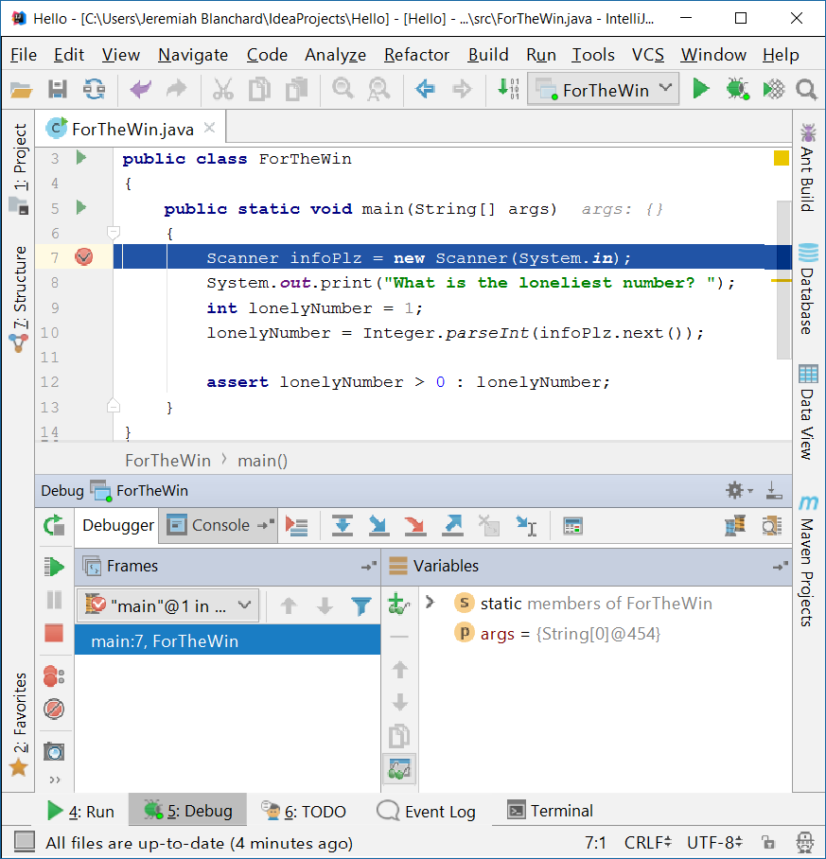
Debuggers
Most IDEs are integrated with a debugger which provides tools for debugging:
Breakpoints
Step-through
Stack trace
Variable watch
In most cases, you must run in the debug configuration (debug mode) to enable the debugger.

